Slide 1
Marimba Makers

Slide 2
Whiteboard Warm-Up
185 or 18.5
Place Value Bubble Numeral:
Write these improper fractions as mixed numbers
11/3 15/6 23/10
Write these mixed numbers as improper fractions.
2 and 3/5 6 ¼ 80 ½

Slide 3
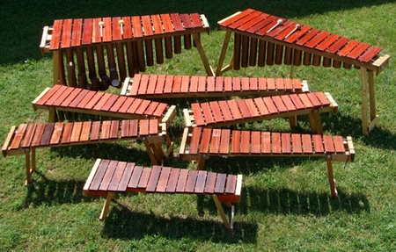
To make a marimba, the instrument maker must cut each of the wooden pieces and pipes using different lengths. The different key lengths are what create the different tones.

Slide 4
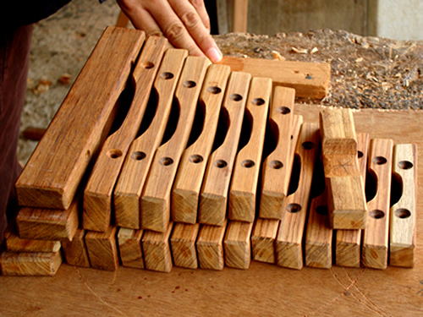
How many marimba keys can be made from each length?
Length of the Board | Key Size
8/9 meter | 2/9 meter
9/12 meter | 3/12 meter
7/9 meter | 3/9 meter
1 and 3/10 meters | 2/10 meter
11/9 meter | 3/9 meter

Slide 5
Exit Ticket
1. The length of the board is 15/4 meters. How many ¾ meter keys are able to be made?
2. The length of the board is 8/5 meters. How many 3/5 meter keys are able to be made?

