Slide 1
Fantastic Fractions Cont’d
Dividing fractions with unlike denominators - 6.NS.1

Slide 2
I CAN…
Partition a fraction into equal fractional pieces.
Find equivalent fractions.
Solve word problems involving division of fractions and whole numbers by fractions.

Slide 3
Warm-up in your math journal
Draw a visual to show how many ½ pieces are in 4.
Draw a visual to show how many ¼ pieces are in 4.
Draw a visual to show how many 1/8 pieces are in 4.
Draw a visual to show how many 2/3 pieces are in 4.

Slide 4
Warm-up in your math journal
Find equivalent fractions for ½.
Find equivalent fractions for ¾.
Find equivalent fractions for 2/3.
Draw a visual to show how many ¼ pieces are in ½.
Draw a visual to show how many 1/8 pieces are in ¾.
Draw a visual to show how many 2/3 pieces are in 8/6.

Slide 5
Christmas decorations task
The elves are preparing for Christmas. They are making bows for presents from red, green, and white ribbon. They need:
red strips of ribbon that are 1/4 of a meter
green strips that are 3/4 of a meter
white strips that are 2/3 of a meter long.
They have one spool of each ribbon color. The spools are each 3 meters long. How many bows of each color can they make?

Slide 6
extensions
a. What if the spools of ribbon were 9 meters long?
b. What if the spools of ribbon were 12 meters long?
c. What if the spools of ribbon were 8 meters long?

Slide 7
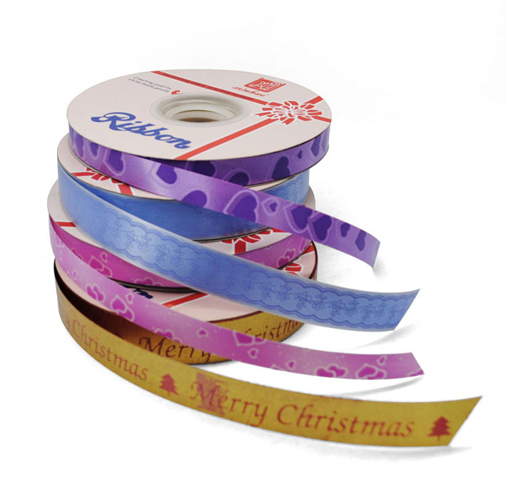
Ribbon count
2. The elves want the same number of red and green ribbons. How many spools of red ribbon and green ribbon will they have to use to have an equal amount of both?

Slide 8
Extensions
a. What if they wanted twice as many green ribbons as red ribbons?
b. What if they wanted ½ as many green ribbons as red ribbons?
c. What if they wanted four times as many red ribbons as green ribbons?

Slide 9
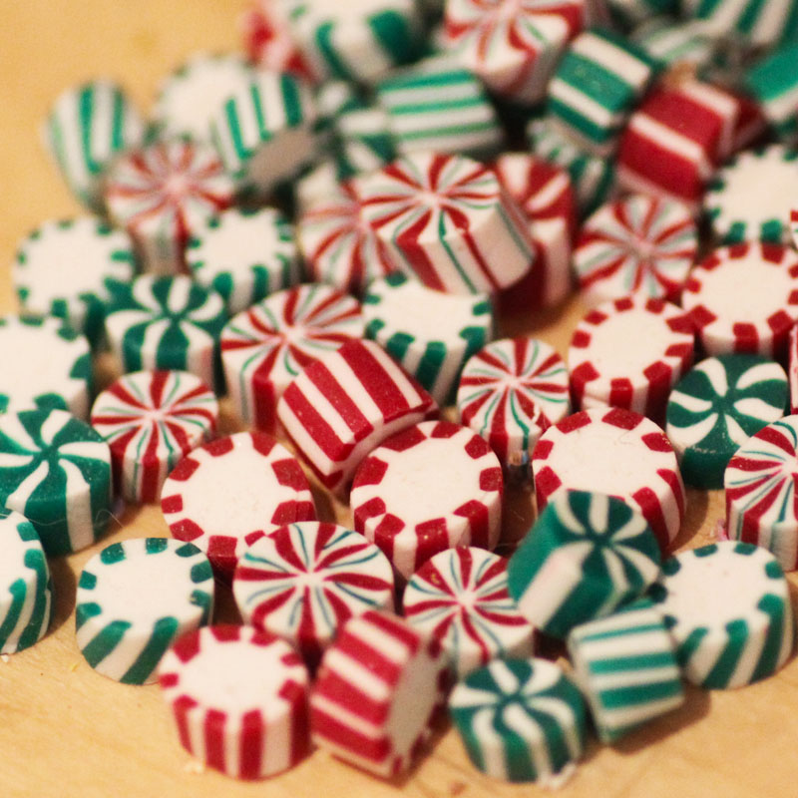
Packaging candy
3. The Sweet Tooth Elves are packaging Christmas candy for stockings. They have ¾ pound (lb.) of candy. They put 1/8 of a pound in each stocking. How many stockings can they fill?

Slide 10
extensions
How many stockings can be filled with ½ pound of candy?
How many stockings can be filled with 7/8 pound of candy?
How many stockings can be filled with 1 3/4 pound of candy?

Slide 11
Frosting Gingerbread houses
4. After packaging the candy, the Sweet Tooth Elves began frosting gingerbread houses. They had only 4/5 of a cup of frosting left! Each gingerbread house needed 1/5 of a cup. How many gingerbread houses could be completed?

Slide 12
extensions
How many gingerbread houses could be completed with 2 cups of frosting?
How many gingerbread houses could be completed with 1 and 2/5 cups of frosting?
How many gingerbread houses could be completed with 9/10 cup of frosting?

